Slide 1

The Quest to Automate Fact-Checking
Chengkai Li
Associate Professor, Department of Computer Science and Engineering
Director, Innovative Database and Information Systems Research (IDIR) Laboratory
University of Texas at Arlington

Slide 2
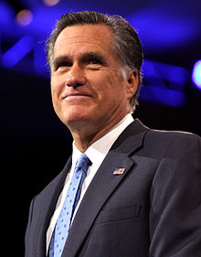
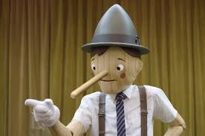
People Make Claims All the Time
“… our Navy is smaller than it's been since 1917", said Republican candidate Mitt Romney in third presidential debate in 2012.
http://en.wikipedia.org/wiki/Mitt_Romney
http://www.thebrainchildgroup.com/

Slide 3
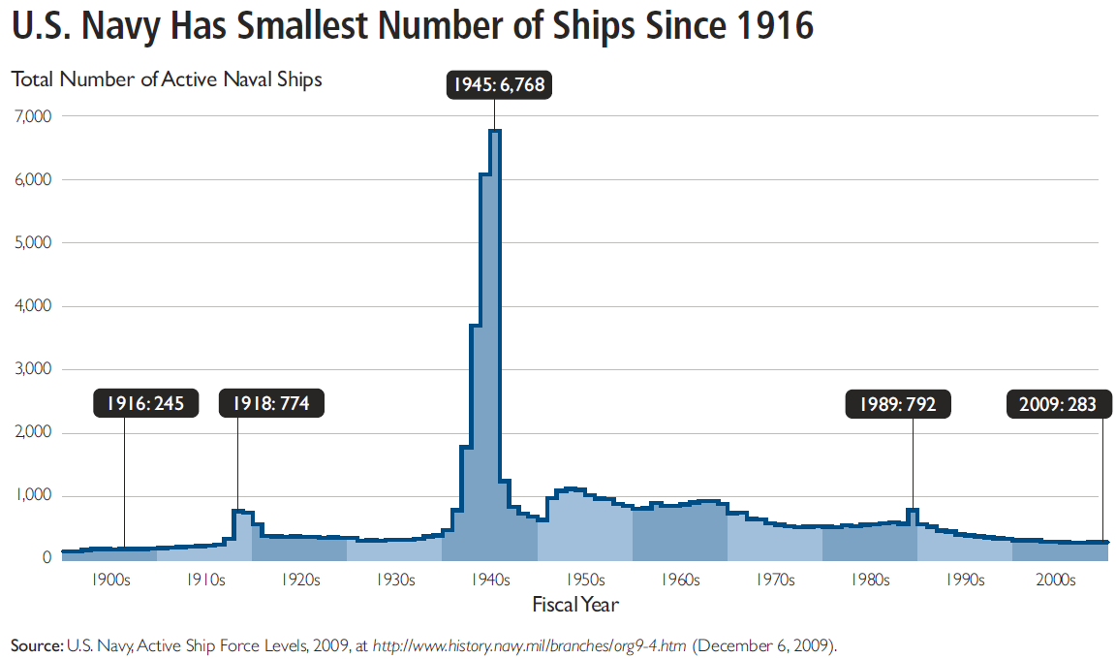
Fact-checking is not Easy
“… our Navy is smaller than it's been since 1917", said Republican candidate Mitt Romney in third presidential debate in 2012.
http://en.wikipedia.org/wiki/Mitt_Romney
http://s3.amazonaws.com/thf_media/2010/pdf/Military_chartbook.pdf

Slide 4
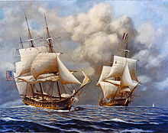
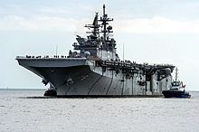
Fact-checking is not Easy
“… our Navy is smaller than it's been since 1917", said Republican candidate Mitt Romney in third presidential debate in 2012.
vs
http://en.wikipedia.org/wiki/Mitt_Romney
http://s3.amazonaws.com/thf_media/2010/pdf/Military_chartbook.pdf
http://en.wikipedia.org/wiki/United_States_Navy

Slide 5
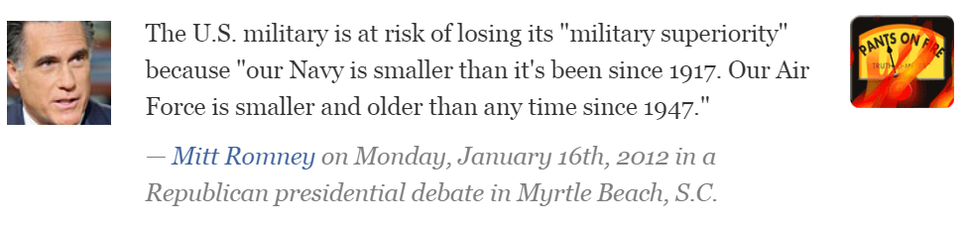
Existing Fact-checking Platforms
Journalists and reporters spend good amount of time on fact checking
96 active fact-checking sites in 2016 (PolitiFact .com, FactCheckEU.org, FullFact.or , Factcheck .org
CNN, Washington Post , New York Times, Poynter, American Press Institute, …)
https://reporterslab.org/global-fact-checking-up-50-percent/

Slide 6
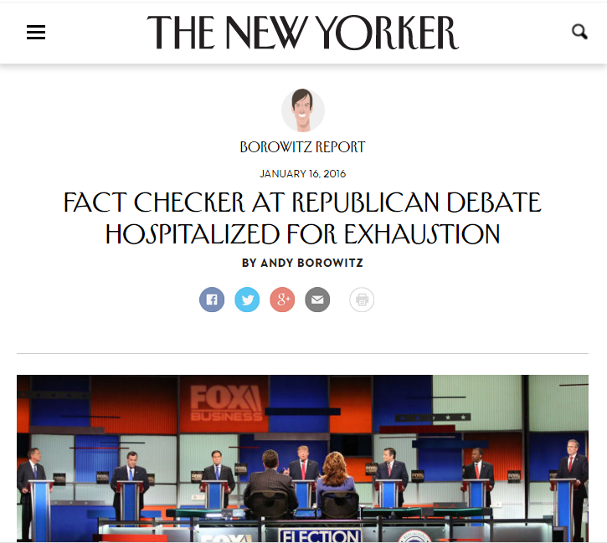
“Total Physical and Mental Collapse”

Slide 7
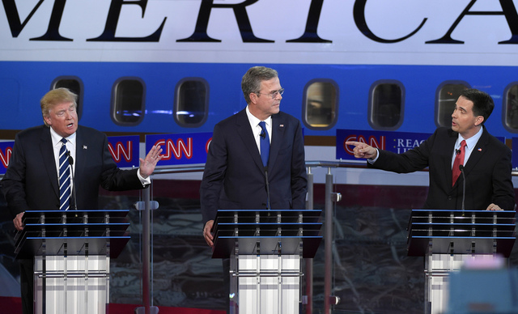
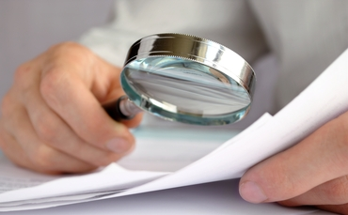
ClaimBuster for 2016
2016
Presidential
Debates
Factual claims recommended for checking

Slide 8


Fact-Checking Presidential Debates
2016
Presidential
Debates
Human Annotation
Feature Extraction
Learning Algorithm
Ground Truth
Feature Vectors
Presidential Debate Transcripts (1960-2012)
Factual claims recommended for checking

Slide 9
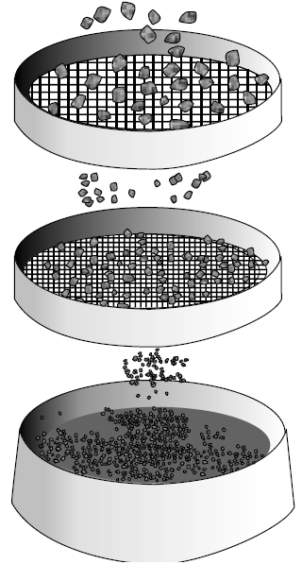
Ground Truth Collection
10 months (in 3 stages)
~$3,000 paid
1032 screening sentences (by 3 experts) to detect spammers & low-quality coders
329 coders
51925 labels
53 top-quality coders
26853 labels
Class | Count
CFS | 1561
UFS | 418
NFS | 5347
53 top-quality coders
14652 labels in agreement
7326 admitted sentences
http://www.engineersdaily.com/2014/03/basics-of-soil-compaction.html

Slide 10
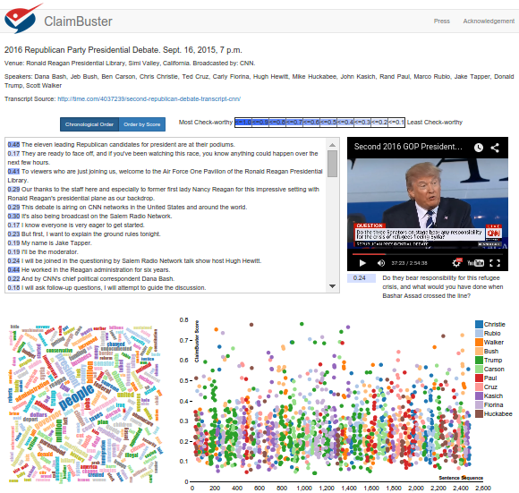
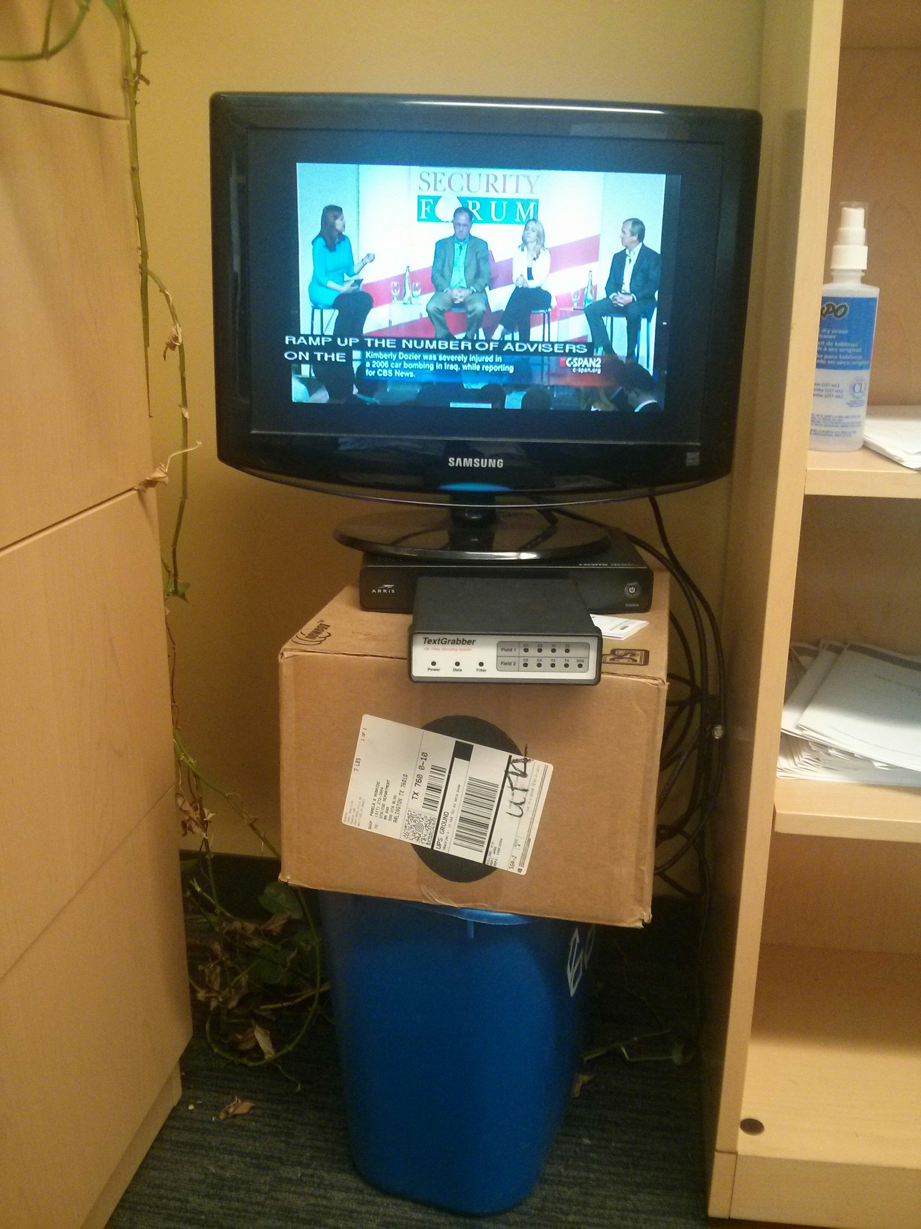
Live Coverage of Debates

Slide 11
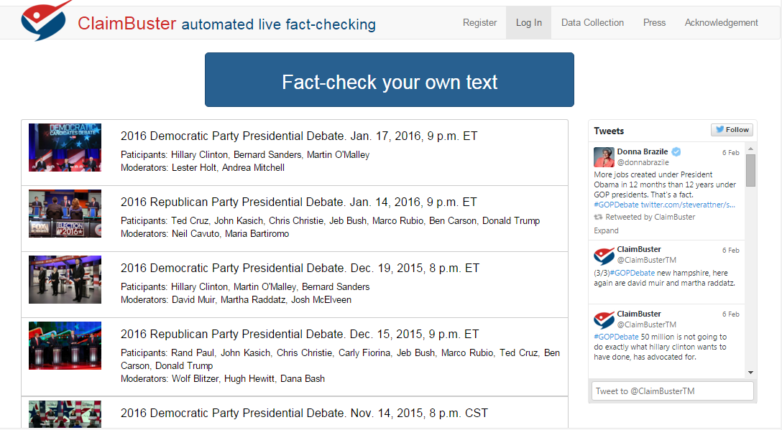

Slide 12
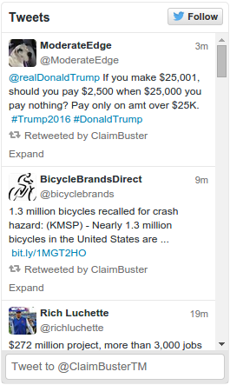
Retweeting Claims in Tweets

Slide 13
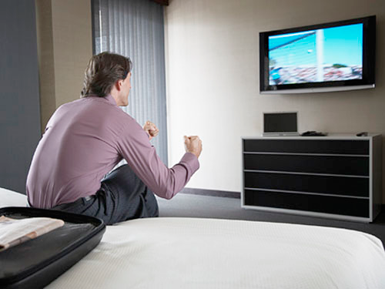
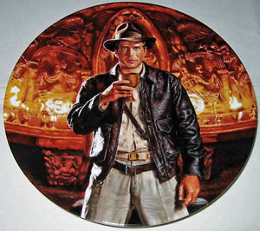
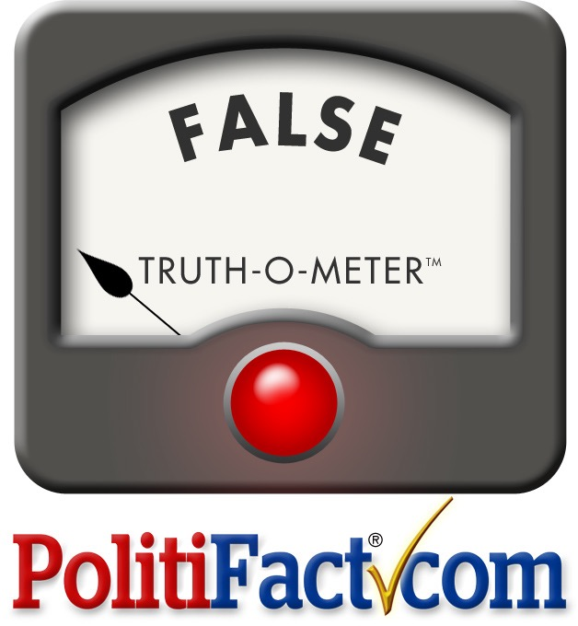
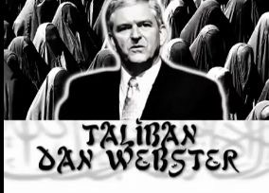
The Holy Grail: Automated, Live Fact-Checking
Source: Bill Adair

Slide 14
ClaimBuster: What to be Done
live events (debates, interviews, congressional debates) and ads on TV and online video streams
social media (e.g., twitter)
web pages
news articles
repository of already-checked claims
important factual claims
detector
matcher
no match
matched
solicit analyses from professionals;
crowd;
data analysis, algorithmic fact-checking
display existing fact-checkers, delivered via browser extensions, mobile and smart-TV apps
www.wsandb.co.uk/wsb/news/2405401/european-court-rules-insurers-need-to-include-economic-consequences-of-policies#
www.outsidethebeltway.com

Slide 15

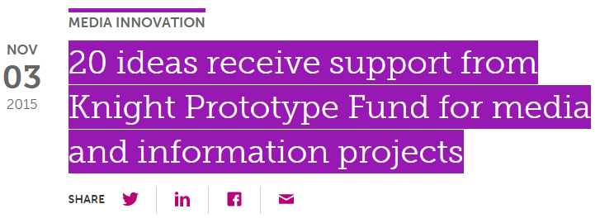
Media Coverage

Slide 16

Commercialization

Slide 17
Application Areas
Journalism
Public relations
Opposition research
Vetting Crowdfounding projects

Slide 18
Timeline and Budget
80K (GRA, faculty salary, data collection, materials)
for 2 years
to develop some of the components
for one of the applications

Slide 19
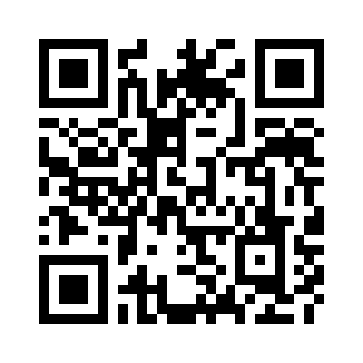
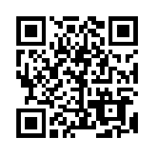
Thank You! Questions?
http://ranger.uta.edu/~cli
cli@uta.edu
Prototype
http://idir.uta.edu/claimbuster
You are invited to contribute
http://bit.ly/claimbusters

